Slide 1
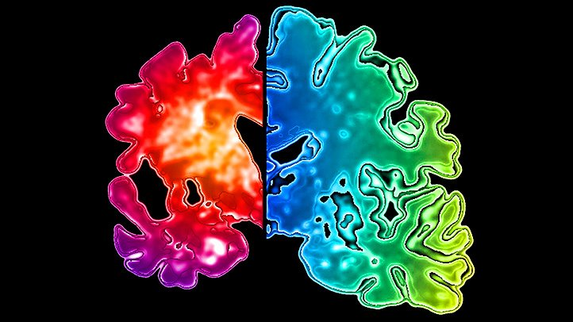
Alzheimer’s Disease

Slide 2
Who are you?

Slide 3
Where am I?

Slide 4
What is Alzheimer’s Disease?

Slide 5
What we will discuss
Alzhemer’s disease and Dimentia
Features of Alzhemers
Diagnosis of Alzheimers
Treatment of Alziemers

Slide 6
Dementia VS Alzheimer’s Disease
Is there any difference?

Slide 7
Features of Alzhiemer’s Disease
A specific disease that interferes with daily life
Slow and progressive
Irreversible damage to brain
Think and memory are effected
Treatments available, but no cure

Slide 8
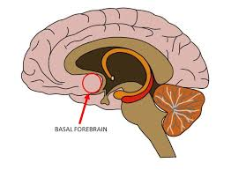
Neurological Features of Dementia
Loss of cholinergic cells in the basal forebrain

Slide 9
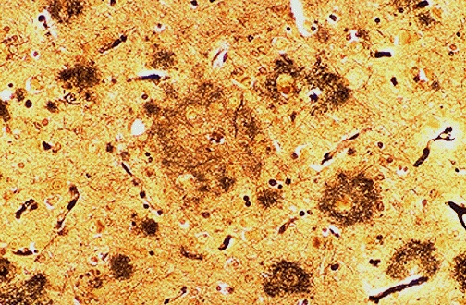
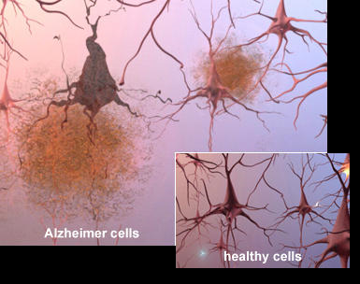
Neurological Features of Dementia
Neurotic plaques
https://library.med.utah.edu/WebPath/CNSHTML/CNS090.html
ALZ.ORG

Slide 10
Diagnosis of Alzheimer’s Disease
Can be confirmed after death by looking for plaques and degeneration in brain tissue
Test are used to assess a patients cognitive ability such as memory and thinking ability
MRI

Slide 11
The Alzheimer’s Brain Video
Video of Brain dissection: https://www.youtube.com/watch?v=cqmZFoGvzfU
View time: 2:00-4:00
Notice the reduction in the cortex and in the hippocampus

Slide 12
Treatment
No cure
Exercise
Healthy eating
Acetylcholine agonists such as Aricept, Exelon, and Razadyne
Memantine and donepezil to regulate glutamate

Slide 13
Summary of Alzheimer’s Disease
The most common type of dementia
Characterized by progressive loss of cognitive ability
Physical changes include loss of cells in the basal forebrain and Neuritic plaques.
Diagnosis involves cognitive assessment, possibly MRIs and autopsy.
Treatment includes healthy living, and medications that help with the neurotransmitters Acetylcholine and glutamate.

Slide 14
References
Dementia vs. Alzheimer’s: Which Is It? 11/11/18 https://www.aarp.org/health/dementia/info-2018/difference-between-dementia-alzheimers.html
https://www.alz.org/alzheimers-dementia/what-is-alzheimers
Types of Dementia. (n.d.). Retrieved from https://www.alz.org/alzheimers-dementia/what-is-dementia/types-of-dementia
https://library.med.utah.edu/WebPath/CNSHTML/CNS090.html (IMAGE)

